Slide 1

TENSORFLOW 2.0
PRACTICAL ADVANCED

Slide 2

TRANSFER LEARNING

Slide 3
WHAT IS TRANSFER LEARNING?

Slide 4
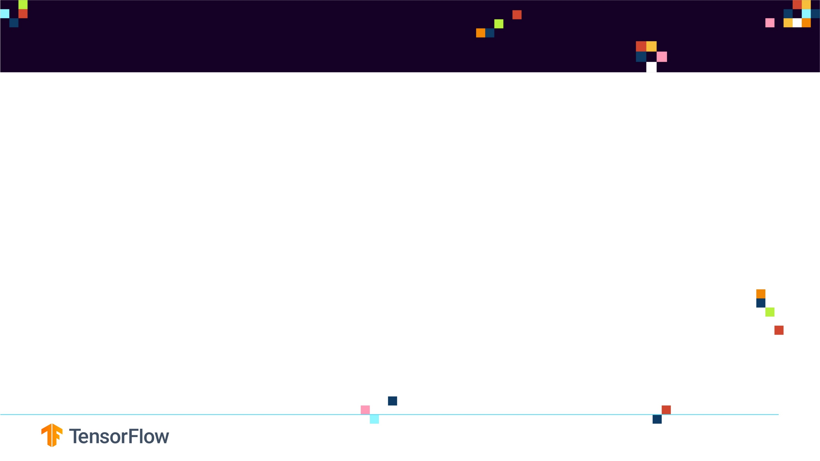
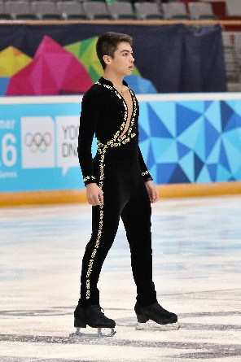
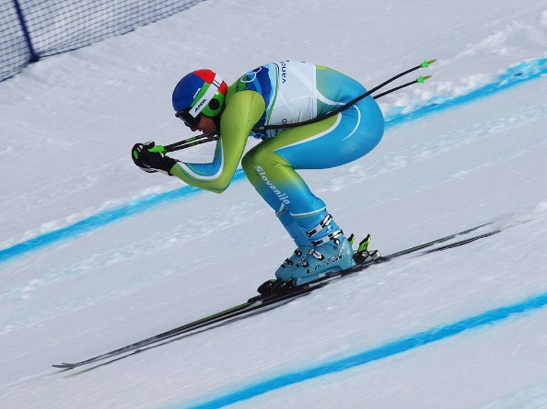
WHAT IS TRANSFER LEARNING?
Transfer learning is a machine learning technique in which a network that has been trained to perform a specific task is being reused (repurposed) as a starting point for another similar task.
Transfer learning is widely used since starting from a pre-trained models can dramatically reduce the computational time required if training is performed from scratch.
KNOWLEDGE TRANSFER
Photo Credit: https://commons.wikimedia.org/wiki/File:Lillehammer_2016_-_Figure_Skating_Men_Short_Program_-_Camden_Pulkinen_2.jpg
Photo Credit: https://commons.wikimedia.org/wiki/Alpine_skiing#/media/File:Andrej_%C5%A0porn_at_the_2010_Winter_Olympic_downhill.jpg
Citations: Olga Russakovsky, Jia Deng, Hao Su, Jonathan Krause, Sanjeev Satheesh, Sean Ma, Zhiheng Huang, Andrej Karpathy, Aditya Khosla, Michael Bernstein, Alexander C. Berg and Li Fei-Fei.
ImageNet Large Scale Visual Recognition Challenge. arXiv:1409.0575, 2014.

Slide 5
WHAT IS TRANSFER LEARNING
“Transfer learning is the improvement of learning in a new task through the transfer of knowledge from a related task that has already been learned”—Transfer Learning, Handbook of Research on Machine Learning Applications, 2009.
In transfer learning, a base (reference) Artificial Neural Network on a base dataset and function is being trained. Then, this trained network weights are then repurposed in a second ANN to be trained on a new dataset and function.
Transfer learning works great if the features are general, such that trained weights can effectively repurposed.
Intelligence is being transferred from the base network to the newly target network.

Slide 6
TRANSFER LEARNING PROCESS

Slide 7
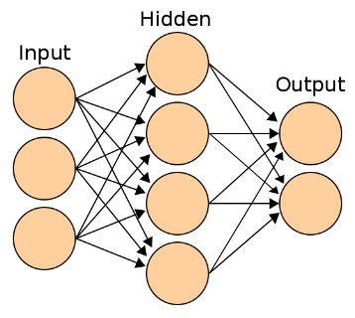
TRANSFER LEARNING PROCESS
CONVOLUTIONAL LAYERS
FULLY CONNECTED (DENSE) LAYERS
ImageNet
CONVOLUTION
CONVOLUTION
FLATTENING
AFRICAN ELEPHANTS
SNAKES
LIONS
KERNELS/
FEATURE DETECTORS LAYER #1
KERNELS/
FEATURE DETECTORS LAYER #2
TRANSFER TRAINED PARAMETERS
NEW DENSE LAYERS TRAINED ON SPECIFIC TASK
NEW IMAGES
CONVOLUTION
CONVOLUTION
FLATTENING
KERNELS/
FEATURE DETECTORS LAYER #1
KERNELS/
FEATURE DETECTORS LAYER #2
CATS
DOGS

Slide 8
WHY DO WE KEEP THE FIRST LAYERS?
The first CNN layers are used to extract high level general features.
The last couple of layers are used to perform classification (on a specific task).
So we copy the first trained layers (base model) and then we add a new custom layers in the output to perform classification on a specific new task.
GENERAL FEATURES
CLASSIFICATION SPECIFIC LAYERS
CONVOLUTIONAL LAYERS
FULLY CONNECTED (DENSE) LAYERS
ImageNet
CONVOLUTION
AFRICAN ELEPHANTS
SNAKES
LIONS
KERNELS/
FEATURE DETECTORS LAYER #1
KERNELS/
FEATURE DETECTORS LAYER #2

Slide 9
TRANSFER LEARNING STRATEGIES AND ADVANTAGES

Slide 10
TRANSFER LEARNING TRAINING STRATEGIES
Strategy #1 Steps:
Freeze the trained CNN network weights from the first layers.
Only train the newly added dense layers (with randomly initialized weights).
Strategy #2 Steps:
Initialize the CNN network with the pre-trained weights
Retrain the entire CNN network while setting the learning rate to be very small, this is critical to ensure that you do not aggressively change the trained weights.

Slide 11
TRANSFER LEARNING ADVANTAGES
Transfer learning advantages are:
Provides fast training progress, you don’t have to start from scratch using randomly initialized weights
You can use small training dataset to achieve incredible results
When to use transfer learning?
When there is a small training dataset available for your new task but there exist a large dataset in a different domain (such as ImageNet)
When you have limited computational resources (GPU, TPU)

Slide 12
WHAT IS IMAGENET?

Slide 13
WHAT IS IMAGENET?
ImageNet is an open source repository of images consisting of 1000 classes and over 1.5 million images
Sample Classes are as shown below:
Check This out: http://www.image-net.org/ and search for ‘elephant’!
949: 'strawberry',
950: 'orange',
951: 'lemon',
952: 'fig',
953: 'pineapple, ananas',
954: 'banana',
955: 'jackfruit, jak, jack',
956: 'custard apple',
957: 'pomegranate',
958: 'hay',
959: 'carbonara',
960: 'chocolate sauce, chocolate syrup',
961: 'dough',
962: 'meat loaf, meatloaf',
963: 'pizza, pizza pie',
964: 'potpie',
965: 'burrito',
966: 'red wine',
967: 'espresso',
968: 'cup',
969: 'eggnog',
{0: 'tench, Tinca tinca',
1: 'goldfish, Carassius auratus',
2: 'great white shark, white shark
3: 'tiger shark, Galeocerdo cuvieri',
4: 'hammerhead, hammerhead shark',
5: 'electric ray, crampfish, numbfish, torpedo',
6: 'stingray',
7: 'cock',
8: 'hen',
9: 'ostrich, Struthio camelus',
10: 'brambling, Fringilla montifringilla',
11: 'goldfinch, Carduelis carduelis',
12: 'house finch, linnet, Carpodacus mexicanus',
13: 'junco, snowbird',
14: 'indigo bunting, indigo finch, indigo bird, Passerina cyanea',
15: 'robin, American robin, Turdus migratorius',
16: 'bulbul',
17: 'jay',
18: 'magpie',
19: 'chickadee',
980: 'volcano',
981: 'ballplayer, baseball player',
982: 'groom, bridegroom',
983: 'scuba diver',
984: 'rapeseed',
985: 'daisy',
986: "yellow lady's slipper,
987: 'corn',
988: 'acorn',
989: 'hip, rose hip, rosehip',
990: 'buckeye, horse chestnut, conker',
991: 'coral fungus',
992: 'agaric',
993: 'gyromitra',
994: 'stinkhorn, carrion fungus',
995: 'earthstar',
996: 'hen-of-the-woods, hen of the woods,
997: 'bolete',
998: 'ear, spike, capitulum',
999: 'toilet tissue, toilet paper, bathroom tissue'}

